Slide 1

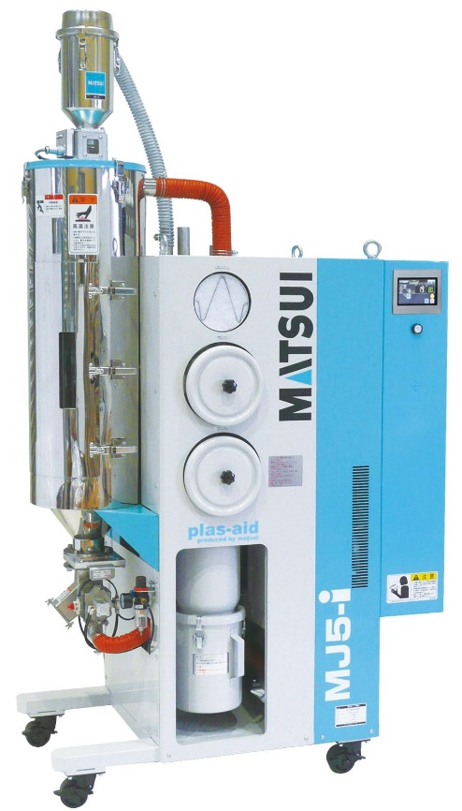
Because
we are MATSUI !
～ MJ5-i ～
Patent No. JP 5420375
（ Japan Patent ）
MJ5-i-150-J

Slide 2
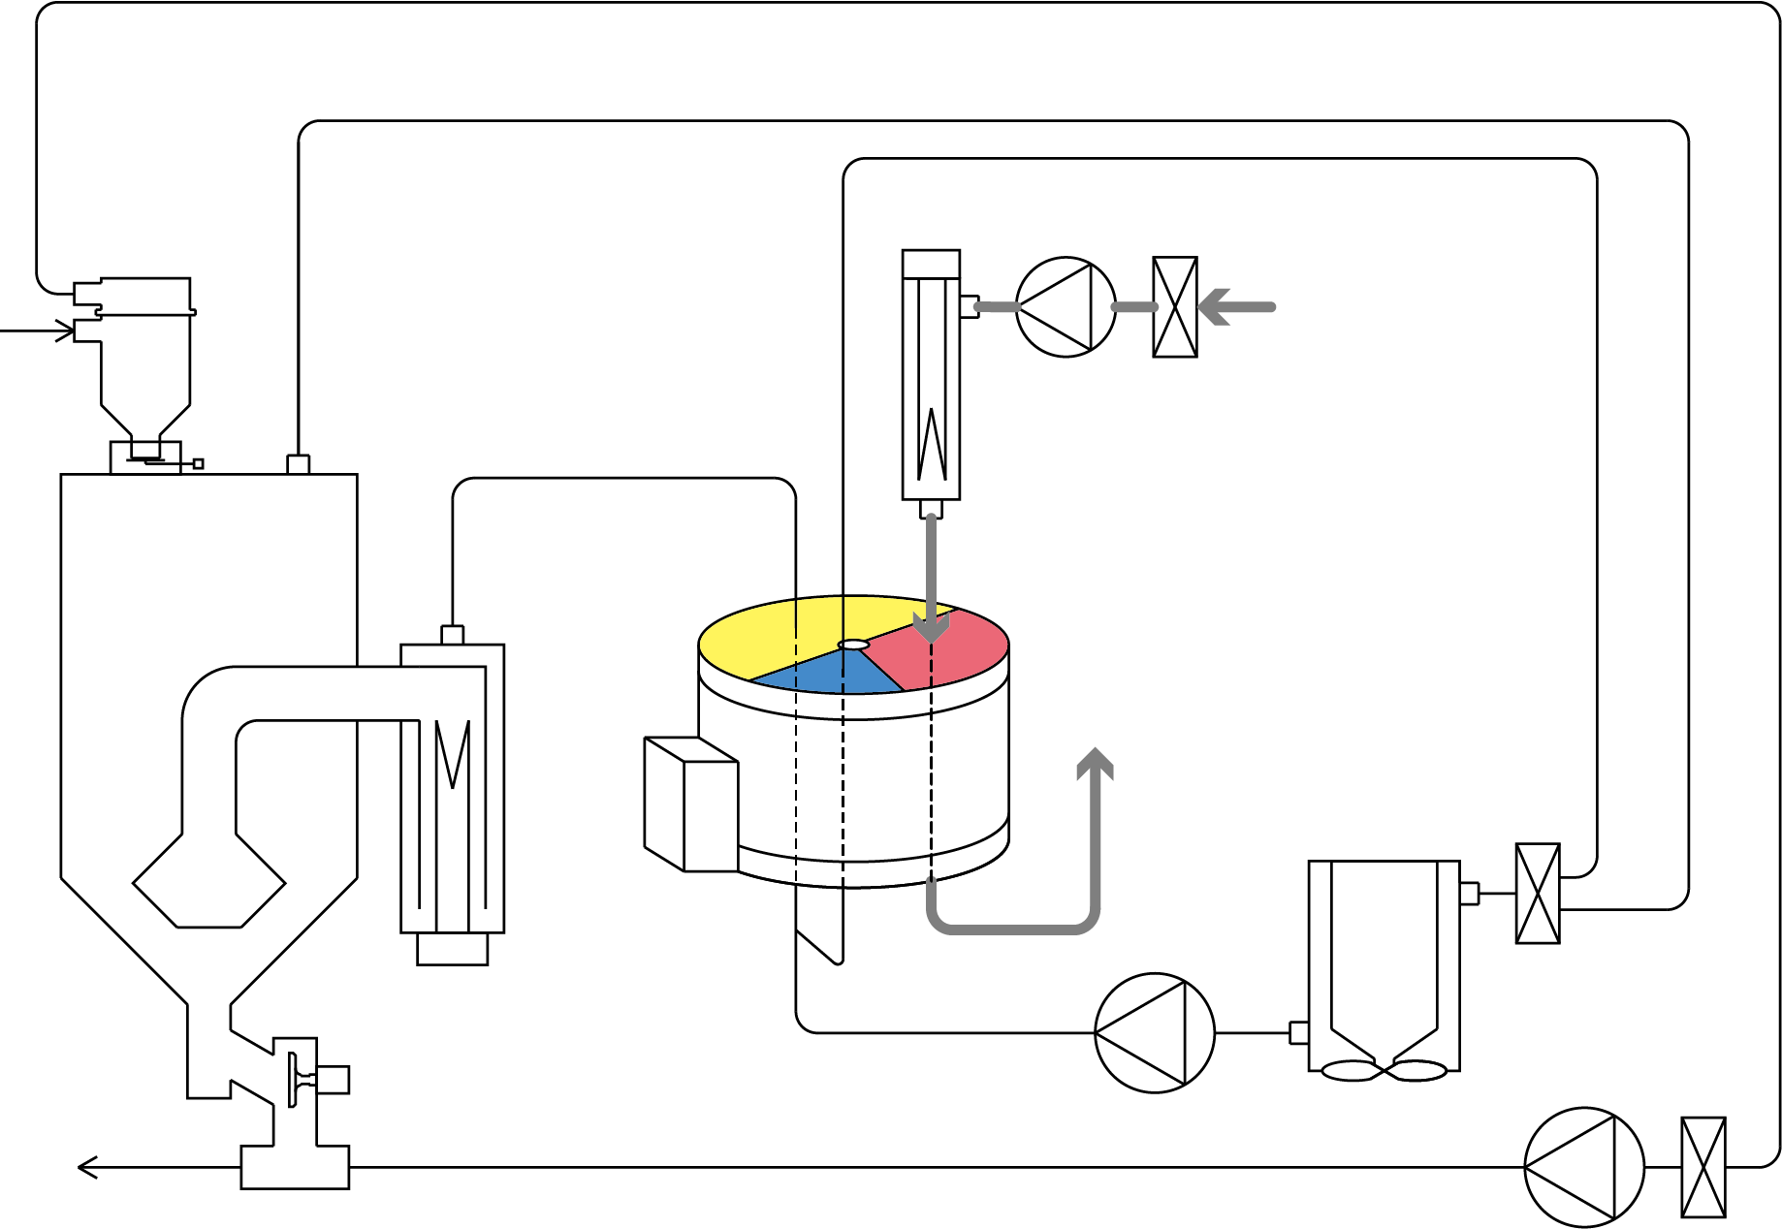

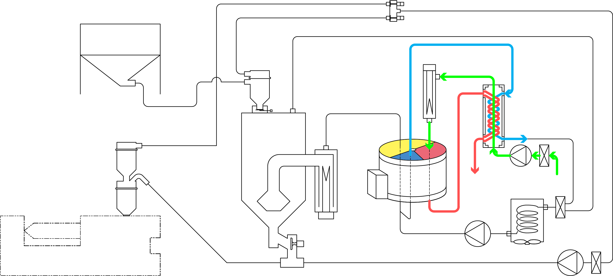
Existing dehumidifying dryer was ...
- The outside air at room temperature
was taken in and heated by
the regeneration heater
- Honeycomb regeneration heating
exhaust was discharged outside
the machine at high temperature
From
material
tank
Regeneration Heater
From outside air
Regeneration
Blower
Drying
Hopper
Drying
Heater
To outside machine
(Waste Heat)
Honeycomb
Rotor
Discharge Valve
Drying Blower
Cooler
To molding machine
Conveying Blower
Honeycomb regeneration heating exhaust and honeycomb regeneration cooling exhaust pass through heat exchanger.
Material Tank
But MJ5-i is
different!
Regeneration
Heater
Drying
Hopper
Heat Exchanger
Drying
Heater
Regeneration
Blower
Honeycomb
Rotor
Discharge Valve
Cooler
Molding Machine
Drying Blower
Conveying Blower

Slide 3


When the outside air at room temperature was
taken in and heated by the regeneration heater,
much energy was required to heat the outside air
at room temperature.
Regeneration Heater
From
material
tank
From outside air
Regeneration
Blower
Drying
Hopper
Drying
Heater
To outside machine
(Waste Heat)
Honeycomb
Rotor
Discharge Valve
Drying Blower
Cooler
To molding machine
Conveying Blower
Preheat the regeneration heating air with
waste heat to reduce the power consumption
of regeneration heater!
Honeycomb regeneration heating exhaust and honeycomb regeneration cooling exhaust pass through heat exchanger.
Material Tank
Regeneration
Heater
Drying
Hopper
Heat Exchanger
Drying
Heater
Regeneration
Blower
Honeycomb
Rotor
Discharge Valve
Cooler
Molding Machine
Drying Blower
Conveying Blower

Slide 4
When the honeycomb regeneration heating exhaust
was discharged outside the machine at high temperature,
the air conditioning equipment was overloaded due to
the high exhaust temperature.
Regeneration Heater
From
material
tank
From outside air
Regeneration
Blower
Drying
Hopper
Drying
Heater
To outside machine
(Waste Heat)
Honeycomb
Rotor
Discharge Valve
Drying Blower
Cooler
To molding machine
Conveying Blower
Honeycomb regeneration heating exhaust and honeycomb regeneration cooling exhaust pass through heat exchanger.
Lower exhaust temperature reduces
air conditioning equipment load and saves energy!
Material Tank
Regeneration
Heater
Drying
Hopper
Heat Exchanger
Drying
Heater
Regeneration
Blower
Honeycomb
Rotor
Discharge Valve
Cooler
Molding Machine
Drying Blower
Conveying Blower

Slide 5


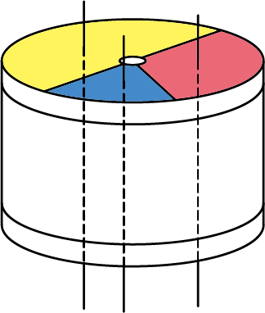
More Details!
Material Tank
Regeneration
Heater
- What does “preheat the regeneration heating air with waste heat” mean?
- Why does the exhaust temperature drop?
Drying
Hopper
Drying
Heater
Heat
Exchanger
Regeneration
Blower
High-temperature honeycomb regeneration heating exhaust and honeycomb regeneration
cooling exhaust exchange heat with low-temperature outside air, then the temperature of
the regeneration heating air is preliminarily raised in temperature.
Honeycomb
Rotor
Discharge Valve
Drying Blower
Cooler
Molding Machine
Conveying Blower
Mechanism of Honeycomb
Mechanism of Heat Exchanger
Regeneration heating air
(Approx. 80℃)
The temperature
introduced to
the regeneration heater rises!
Honeycomb regeneration
cooling exhaust
Heat exchange is
the transfer of heat energy from high-temperature fluid
to low-temperature fluid.
(The heat energy has
the property of moving
from high to low)
Adsorb moisture with honeycomb
Honeycomb
regeneration
heating exhaust
(100-140℃)
Honeycomb
regeneration
cooling exhaust
(150-190℃)
Water evaporation
from honeycomb
Heat Exchanger
No water transfer!
Cool honeycomb to the proper temperature for dehumidification
■: Dehumidification zone
■: Regeneration cooling zone
■: Regeneration heating zone
Exhaust temperature
to outside of
the machine drops!
Regeneration exhaust
(Approx. 80℃)
Cooling exhaust
[Reference]
Overall heat transfer coefficient 33.0 W/(m²・K) (Actual value)
(28.4 kcal/(m²・h・K))
Heat collection rate 67 % (Actual value)
Honeycomb regeneration
heating exhaust
Outside air
(20-35℃)

Slide 6

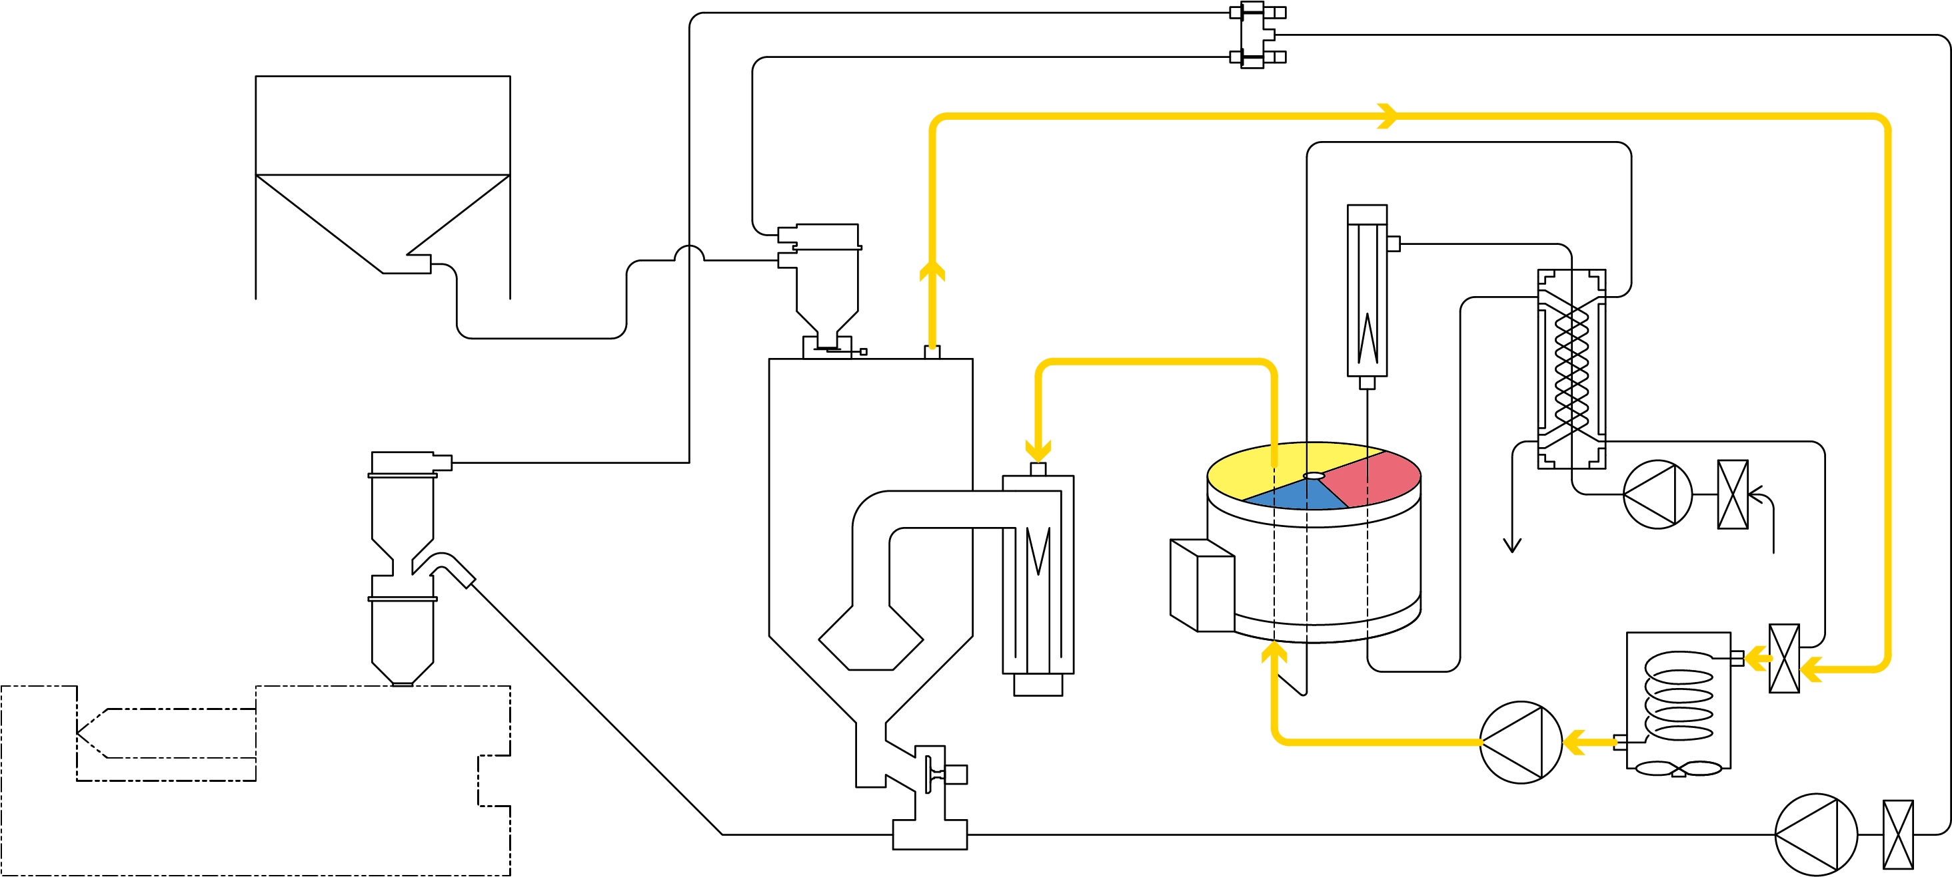
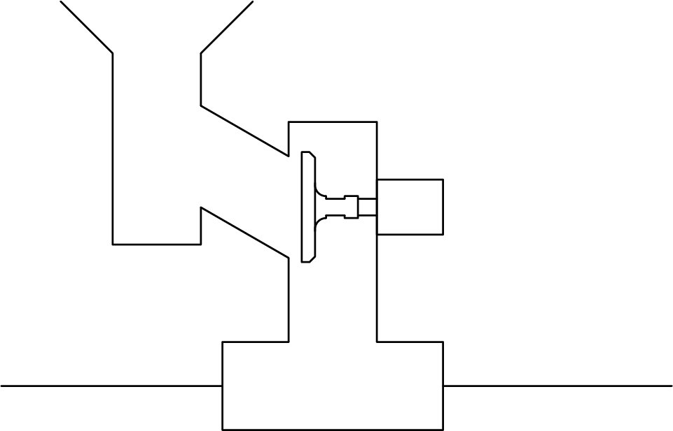
MATSUI technology
also here!
Reabsorption of the material after drying and
temperature drop are reduced by
filling the material conveying line with dehumidified dry air!
Good
Patent No. JP 5130338
Dehumidified Dry Air Circulation Circuit
More Details!
What does “filling the material conveying
line with dehumidified dry air” mean?
Material Tank
Regeneration
Heater
Gap
Drying
Hopper
Drying
Heater
Heat Exchanger
A part of the dehumidified dry air,
supplied to the drying hopper,
flows into the material
conveying pipeline through a gap
between the discharge port.
Regeneration
Blower
Honeycomb
Rotor
Cooler
Molding Machine
Discharge Valve
Drying Blower
～Other expected effects!～
Conveying Blower
Material Conveying Pipeline
Prevent
jammed!
Diagonal mechanism
allows materials to be
discharged smoothly!
The discharge pipe is inclined downward.
Make a gap between the discharge port and the closed discharge valve to prevent material from falling.
Powder pressure
on the valve body is
reduced and the valve
body moves smoothly!
[Reference] When APH is used for the collector, the dew point is -30 to -40 ℃ (actual value)
The material did not reabsorb at in-house test using PET.

Slide 7
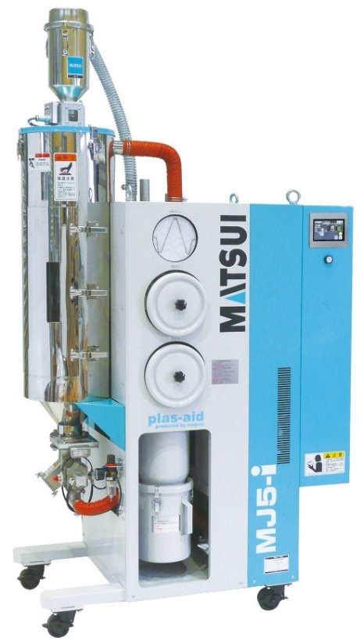
Because
we are MATSUI !
The energy-saving technology of MJ5-i is
MATSUI‘s technology that other companies cannot do.
(Patent No. JP 5420375)
Honeycomb regeneration heating exhaust and honeycomb regeneration cooling exhaust pass through heat exchanger.
MJ5-i-150-J
Material Tank
Regeneration
Heater
Preheat the regeneration heating air with
waste heat to reduce the power consumption
of regeneration heater!
Drying
Hopper
Heat Exchanger
Good
Drying
Heater
Regeneration
Blower
Honeycomb
Rotor
Lower exhaust temperature reduces
air conditioning equipment load and
saves energy!
Good
Discharge Valve
Cooler
Molding Machine
Drying Blower
Conveying Blower

